Slide 1
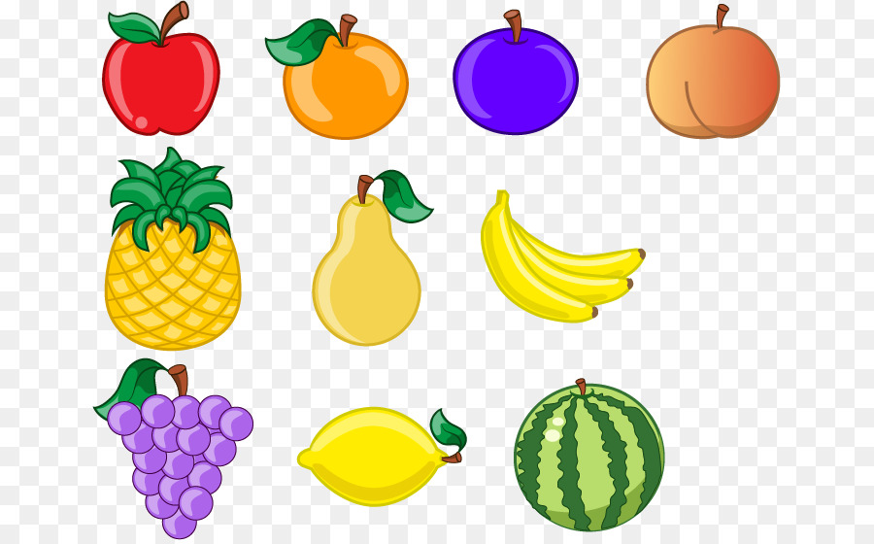
Panda Catcher
Made by Pete studio
Main Creators: Szymon & Krystian

Slide 2
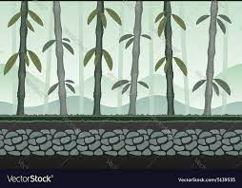

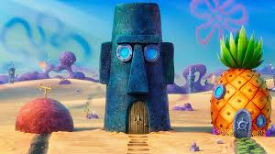

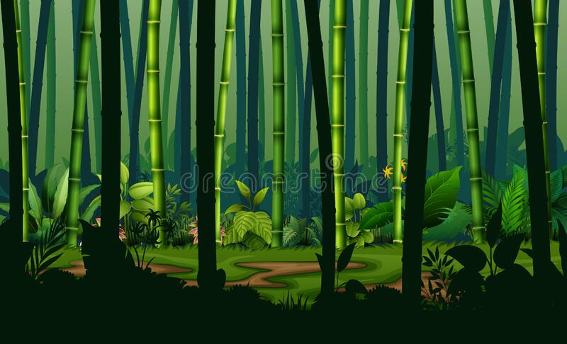
Pillars
The game features beautiful background with fun details in it, each level will be unique from the previous ones, the playable character will be a lovable panda. The game will also test your reflexes to catch the fruits in time

Slide 3

Features
Each level will bring a unique spin on the level and give challenges to the player, the player will also be able to gain equipment from achievements and challenges, which can be used to customise their own panda.
They can unlock cosmetics for the background such as a bamboo plant, or a bird house.

